Slide 1
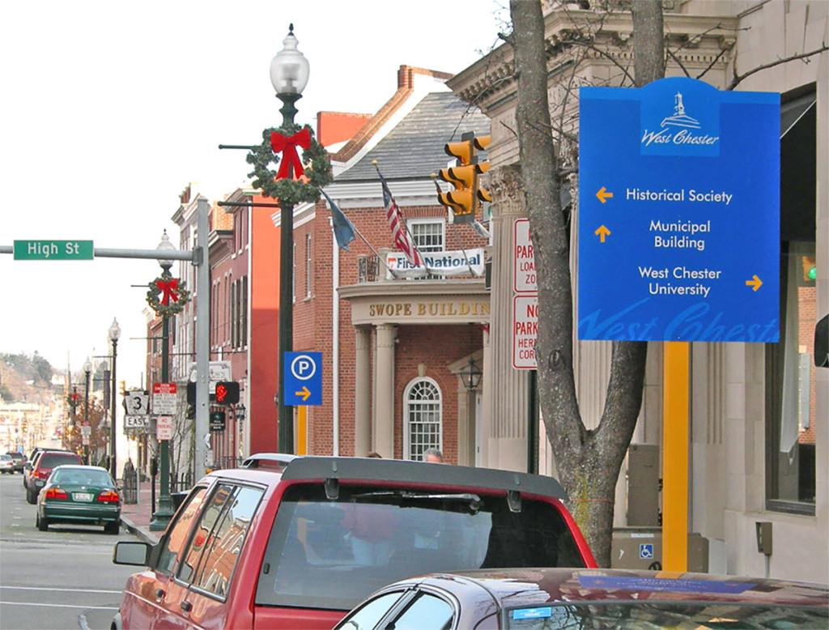
West Chester Borough
Comprehensive Parking Guide:
Recommendations
March 20, 2018

Slide 2

Steps in Developing the Comprehensive Parking Guide
Inventoried all on- and off-street parking facilities controlled and operated by the Borough
Reviewed/verified the boroughs permit types and hours of enforcement
Conducted utilization surveys of on-street metered spaces, off-street facilities and residential permit parking spaces
Evaluated restricted parking areas and enforcement procedures
Assessed informational parking signage and wayfinding
Conducted stakeholder meetings with community members, business owners, residents, and university representatives
Researched parking facility management practices relevant to West Chester
Projected parking demand and performed a surplus/deficit analysis based on future developments and existing utilization
Created a series of transportation demand management strategies and policies to be used by the borough to reduce parking demand in the future
Developed parking recommendation and solutions, tailored to West Chester Borough

Slide 3
Short-Term Recommendations (1-2 Years)
Price off-street hourly parking less than on-street parking and implement first hour free in the garages
  Make on-street parking more readily available for business patrons and visitors
Increase on-street rate in the Business District to $1.00 for the first hour, $2.00 for the second hour and $3.00 per hour thereafter
  Reduce traffic, user frustration, and create a more even spread of on-street parking demand
Eliminate 3-hr. parking time limit at on-street meters in the Business District
  Simplifying on-street parking regulations
Eliminate leased parking from the parking lots in the CBD and replace with permit parking
  Increase parking capacity of off-street long-term parking system in CBD
Long-term parking with no time restrictions should be permitted in the off-street lots in the CBD
  Increase parking capacity of off-street long-term parking system in CBD
Implement wayfinding signage recommendations
  Improve wayfinding and convenience, and reduce user frustration
Restrict public parking on residential streets between 8AM and 12AM
  Make residential parking more readily available for residents

Slide 4
Short-Term Recommendations (cont.)
Increase residential permit rate from $8 to $15 and gradually increase for each additional permit per household
  Make residential parking more readily available for residents
Create a specific residential parking permit for streets within a 2-block radius of the CBD and WCU
  Make residential parking adjacent to WCU and CBD readily available for residents in these areas
Offer single day guest permits at a rate of $1 per permit, and possibly limit guest permits at 50 per year per resident
  Make residential parking more readily available for residents
Increase the business permit rate from $8 to $50 per year
  Make residential parking more readily available for residents
Encourage residents in north part of Borough to establish residential parking areas
  Reduce warehousing of vehicles in residential areas and frustration of residents
Implement street sweeping recommendations
  Reduce resident frustration and increase residential parking capacity
Allow private businesses and developers to create shared parking agreements
  Make economic development in Borough more attractive to developers
Eliminate the 2-block radius requirement for guest permits
  Reduce unavoidable parking violations

Slide 5
Short-Term Recommendations (cont.)
Extend enforcement hours on Saturday
  On-street parking more readily available for business patrons
Increase the Chestnut Street Garage and Bicentennial Garage monthly permit rates
  Evenly spread long-term parking demand between garages
Increase the permit rate in the lots from $50 to $60
  Spread long-term parking demand evenly across off-street system
Offer discounted evening and weekend parking ($5) for the Chestnut, Bicentennial and Sharpless Street Garages
  Provide discounted parking option for evening employees in CBD and offer parking option for residents
Eliminate Area C permit for commuter students and install meters
  Provide parking for short-term parkers to WCU
Investigate potential of consolidating the existing 14 residential permit areas into fewer areas
  Reducing confusion among residential parkers
Work with WCU to reduce student parking demand and effectively utilize WCU parking assets
  Improve both parking and traffic conditions along residential streets

Slide 6
Short-Term Recommendations (cont.)
Potentially remove meters from residential streets
  Reduce cost of maintaining meters
Institute graduate fines for repeat offenders parking too far from the curb
  Improve traffic conditions on narrow street
Snow emergency policies recommendations
  Reduce parking demand for off-street parking during snow emergencies
Shared parking agreement for public parking in the St. Agnes Church/School and Washington Square Apartments Lots
  Increase parking capacity in the CBD
Stack valet vehicles in Borough parking garages or lots
  Increase parking capacity in the CBD
Stage valet parking in private lots that have available parking capacity
  Increase parking capacity in the CBD
Offer free parking to residential permit holders that live along Snow Emergency Route streets
  Effective parking management during snow emergencies

Slide 7
Mid-Term Recommendations (3-5 Years)
Replace single-space meters with multi-space meters
  Reduce streetscape clutter and increase on-street capacity
Install meters at time restricted on-street areas
  Eliminate abuse of long-term parkers using time restricted on-street areas
As needed, install meters on residential streets
  Support short-term parkers to businesses, parking and major activity generators
Add part-time enforcement person and add an additional LPR vehicle
  Reduce parking violations through better enforcement
Implement a virtual guest parking permit program
  Improve convenience for residents and enforcement staff
Relocate Farmers Market to Gay Street
  Free up Lot 10 for development and/or public garage
Implement loading zone recommendations
  Reduce double parking of loading vehicles causing traffic delays
Conduct parking zoning study to determine ideal parking requirements and policies
  Create parking policies that are suited to meet parking needs
Incorporate parking strategies that support a dense and pedestrian-friendly community into zoning
  Support alternative modes of transportation

Slide 8
Long-Term Recommendations (5+ Years)
Event parking recommendations
  Reduce parking demand and traffic during events
Implement TDM strategies
  Promote alternative modes of transportation

